Slide 1
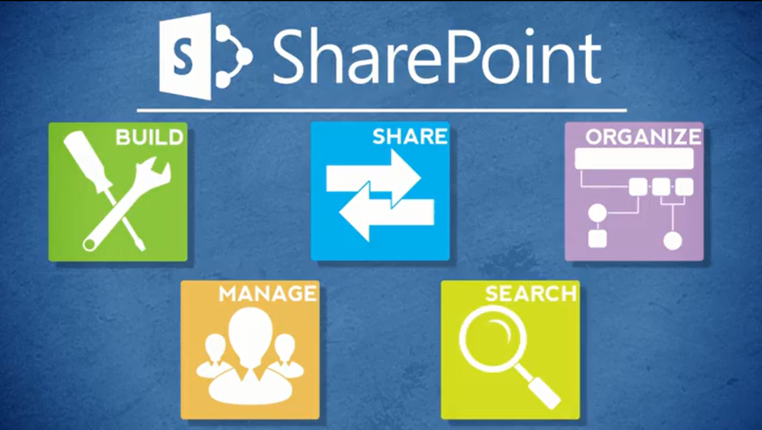
Agenda
Overview
Review
Roles
Lists
Libraries
Columns
Views
Pages
Web Parts
Navigation
Office
Wrap-Up

Slide 2
What is SharePoint?

Slide 3
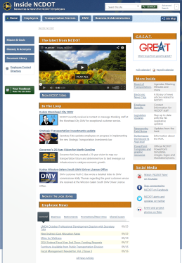
Inside NCDOT Website
SharePoint site for NCDOT employees
The “tabs” part of the site is open to all NCDOT
Project and team sites are reserved for internal collaboration – you need specific permissions to access them

Slide 4
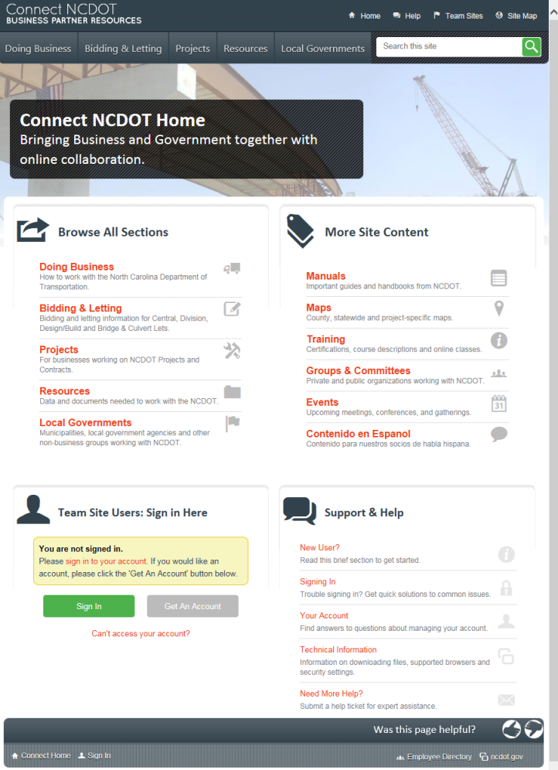
Connect NCDOT Website
SharePoint site for business partners and NCDOT
The “tabs” part of the site is public
Project and team sites are reserved for internal and external collaboration – you need specific permissions to access them

Slide 5
Search
You are familiar with:
Basic search
Refine and sort options on results page
Logical operators (AND, OR, NOT, “”, *)
Metadata (author: filename: filetype: title:)
Transportation Project search

Slide 6
SharePoint Interface
You are familiar with:
Settings gear
Ribbon
Links
Quick links
Logo link
Top and secondary navigation
Breadcrumbs
Quick launch

Slide 7
Items & Lists
You are familiar with:
Terminology – items, list items, lists, properties, metadata
Common lists – announcements, calendar, contacts, custom, links, tasks
You can:
Create, edit, delete and restore an item
Attach a file to an item
Create a personal view; change views
Quick Edit a list
Email a link
View version history of an item, properties of an item
Set and manage alerts
Sort or filter

Slide 8
Files & Libraries
You are familiar with:
Terminology – files, items, documents, libraries, lists, properties, metadata
Common libraries – asset, document, picture
Importance of tagging for search, business content type and data security classification
Naming, titling, formatting and location conventions

Slide 9
Files & Libraries
You can:
Download, upload, create, open, check in, check out, edit, move, delete and restore a file
Create a personal view and change views
View and edit properties of a file
Quick Edit a library
Open library with Explorer
Email a link
View version history of a file and restore a version
Set and manage alerts
Sort or filter

Slide 10
SharePoint & Office
You can:
Use the Connect to Office command
Open, check out, edit, save and check in a SharePoint file in Office
View and edit properties from Office
Export a list to Excel
Overlay a SharePoint calendar on an Outlook calendar

Slide 11
SharePoint Help
You are familiar with:
How to access SharePoint help
How to use role-based help
Help files, videos, presentations, exercises
How to use Quick Reference materials
FAQs, ribbon and tab summaries, command summaries

